Slide 1


ANTLR 4
JDriven : Innovatie Tracks

Slide 2
ANTLR: ANother Tool for Language Recognition
“ANTLR is a powerful parser generator for reading,
processing, executing or translating structured text or
binary files. “
Notes:
- Parser generator: creates a lexer and a parser based on a grammar
- Structured: the information needs to be able to be expressed in a grammar

Slide 3
Creating your very own parser
Create
Grammar
Generate Parser
Implement
AST Visitor

Slide 4
Grammars (the ‘hard’ part)
A grammar is a text file or series of text files that express a formal description of a formal (structured) language.
Grammars are often expressed in Extended Nackus-Naur Form (EBNF)
ANTLR 4 has it’s own EBNF dialect

Slide 5
Simple example grammar
grammar Hello;
greeting: HELLO name;
name: STRING;
HELLO: ‘hello’;
STRING: CHAR+;
fragment
CHAR: [0-9a-zA-Z];
Grammar name
Parser rules
Lexer rules

Slide 6
Parsing our simple message
“hello world”
Byte stream
Lexer
HELLO(hello)
STRING(world)
Token stream
Parser
greeting
Abstract
Syntax
Tree (AST)
HELLO(hello)
name
STRING(world)

Slide 7
Simple calculator grammar
grammar Simple;
calc: expr EOF;
expr
:BR_OPEN expr BR_CLOSE
|expr TIMES expr
|expr DIV expr
|expr PLUS expr
|expr MINUS expr
|number
;
number: NUMBER;
PLUS: 'plus‘ | '+';
MINUS: 'minus‘ | '-';
TIMES: 'times' | '*';
DIV: 'div' | '/';
NUMBER: '-'? [0-9]+;
BR_OPEN: '(';
BR_CLOSE: ')';
WS: [ \t\r\n]+ -> skip;

Slide 8
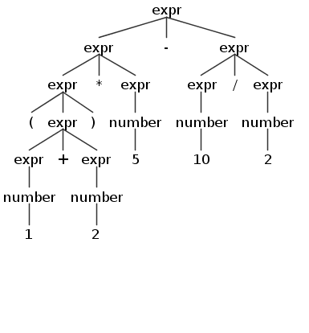
Parse string
“(1 + 2) * 5 - 10 / 2”
calc: expr EOF;
expr
:BR_OPEN expr BR_CLOSE
|expr TIMES expr
|expr DIV expr
|expr PLUS expr
|expr MINUS expr
|number
;
number: NUMBER;

Slide 9
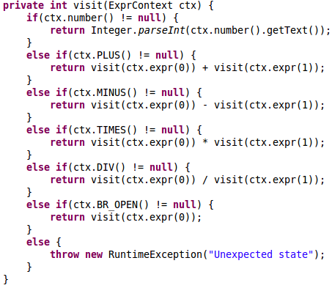
Implement visitor

Slide 10
ANTLR 4 benefits
Relatively easy to use
Grammars are straightforward and forgiving
Gives clear error messages on mistakes
Integrates well with Eclipse and Maven
Shortens implementation time
Faster than writing your own parser
Guaranteed correctness of parse result

Slide 11
Common pitfalls
Lexing and parsing are separate stages
Parser works on token stream from lexer
Lexer only sees byte patterns and is greedy
You might end up with an unexpected token!
Order matters
Parser matches rules in the order of the grammar
Antlr can typically figure out left-recursive rules (expr: expr ‘*’ expr is fine) but not always.

Slide 12
Application in Hansken
JSON Query Language
Parser for the JSON query ‘language’ Ganesha uses to query for traces
{ “term” : {“field”: “file.type”, “value”:”picture” }}
Parser checks for correct syntax

Slide 13
Application in Hansken
Hansken Query Language (HQL)
Similar to the Lucense Query Language used in the demonstrator:
file.size > 1024 and type=picture
“a text to find” or justaword
not file.ext=doc
(file.type=picture or file.type=graphic) and (file.ext= gif)
Easy to write / understand for users
Flexible: just type a single word to text-search, or write a complex query with brackets and and/or/not.

Slide 14
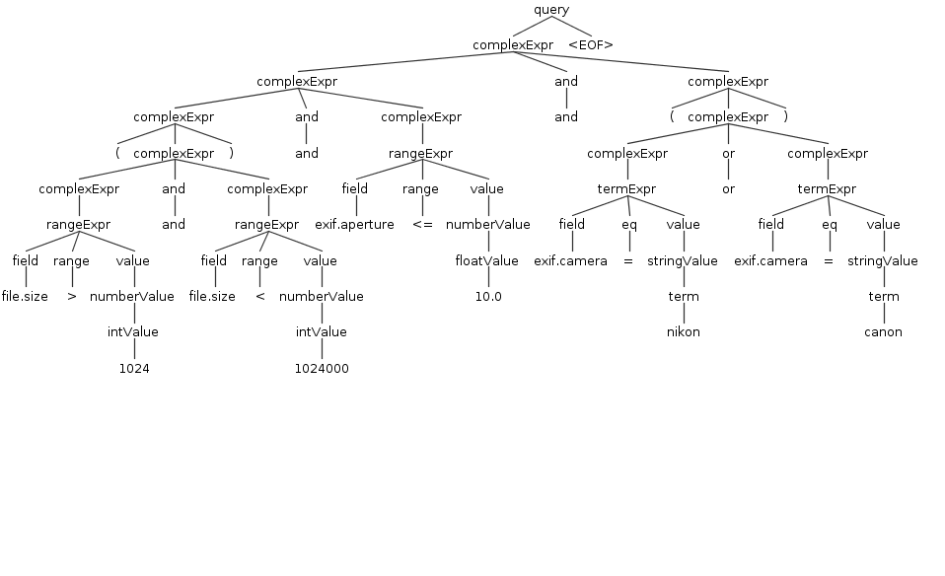
Example HQL query
(file.size>1024 and file.size<1024000) and exif.aperture<=10.0 and (exif.camera =nikon or exif.camera=canon)

Slide 15
From query to result
Parse HQL query
Build Trace Query Object Tree
Send Tree to Trace Server
Return results

Slide 16
Thank you!
Any questions?
Github repository with example project and links:
https://github.com/nielsutrecht/antlr-pres

Slide 17
JDriven : Kennismodel
Backend
Frontend
Mobile
Architecture
Agile / Scrum
Vakmanschap
Persoonlijk
Core
Spring

